Slide 1
IoT 서비스 환경에서 정보보호 방안
Information Protection Method in IoT Services
Mobile Database Management

Slide 2
Table of Contents
List
Examples of IoT Services
Case of Violation of IoT Services
Information Protection of IoT Services
Conclusion and Future Business Model
List

Slide 3
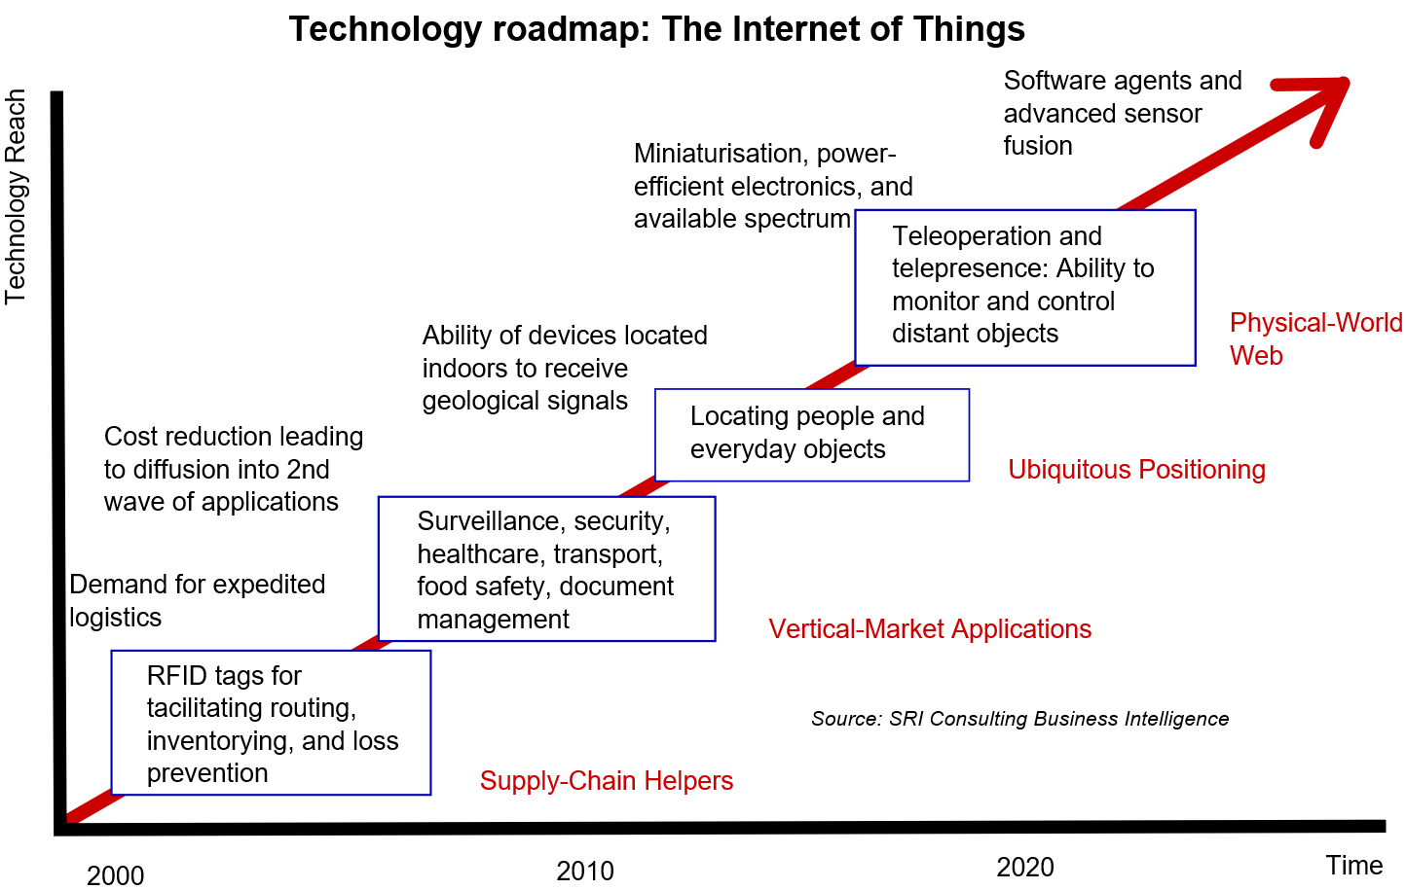
1. Examples of IoT Services(1/3)
IoT Services
Source: SRI Consulting Business Intelligence

Slide 4


1. Examples of IoT Services(2/3)
Situation
37.xxx 126.yyy
Where is my daughter?
Query
Result
Father
Daughter
Notes:
Delete "or etc." and just have "Daughter".

Slide 5
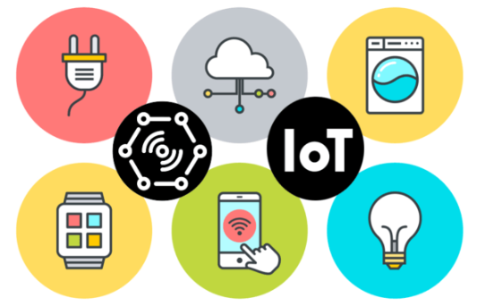
1. Examples of IoT Services(3/3)
Limitations of IoT Services
Insecure Web Interface
User ID, Session, etc. Improper management
Insufficient Authorization
Complexity and length of password
Privacy Concerns
Client’s name, address, birth date, location, etc.
Insecure Software/Firmware
From Cloud to Devices encryption, operation, fabricate

Slide 6
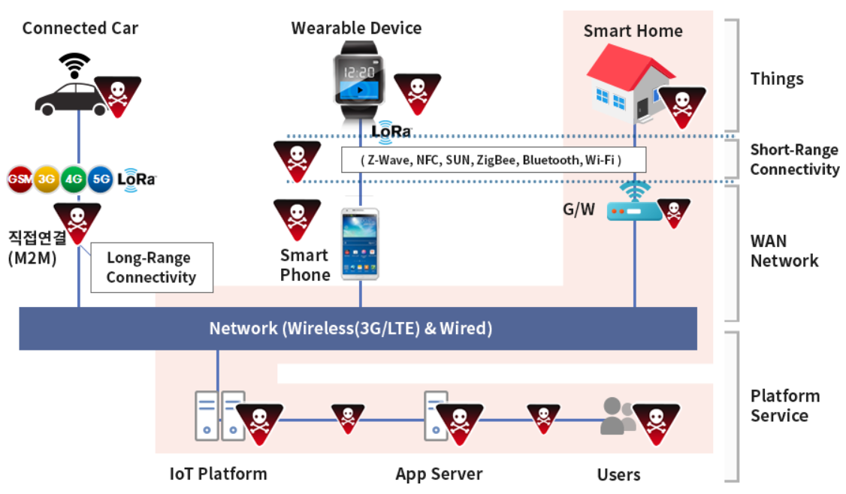
2. Case of Violation of IoT services
Source: INITECH

Slide 7

2. Case of Violation of IoT Services
Example of IoT Service Violation
② coordinates:
37.3xx 126.5yy
Where is my daughter?
Query
Result
Father
3rd attacker
Daughter

Slide 8

3. Information Protection of IoT Services
② coordinates:
1. 37.3xx 126.5yy
2. 38.5xx 77.0yy
Motivation
① Where is my daughter?
…
Query
Result
Father
3rd attacker
Daughter

Slide 9


3. Information Protection of IoT Services
Error probability of Results
② coordinates:
1. 37.3xx 126.5yy
(Seoul) [ O ]
2. 38.5xx 77.0yy (Washington, D. C.) [ X ]
…
3rd attacker

Slide 10
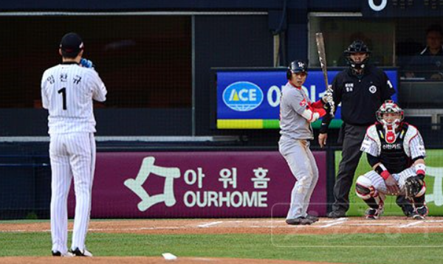
3. Information Protection of IoT Services
Solution
②: Result
Types
??
①: Query
Types
Source: Sports donga

Slide 11
3. Information Protection of IoT Services
Consideration
Query type
Kind of IoTs, Query contents
Effective range
Query result of IoTs
k
The number of virtual data
Scheduling
Set of the transmission data

Slide 12
3. Information Protection of IoT Services
Algorithm 1 [Query Types(Client/Requester)]
Input: Select the kind of IoTs you want to request
Output: Request query contents for selected IoT, k
set the receiving data type
01: Input check;
02: while(select the IoT requested by the Input)
03: if(IoT == IoT requested by client)
04: set the type of data to receive;
05: end if
06: end while
07: return Query Types;

Slide 13
3. Information Protection of IoT Services
Algorithm 2 [Result Types(IoT/Server)]
Input: Query contents and receiving data type of algorithm 1
Output: Effective range of query results, set of the trans-
mission data
01: Input check;
02: while(select the result type requested by the Input)
03: if(result type == requested type by client)
04: set the effective range of the data to be transferred;
05: while(result data < k)
06: generate virtual data(including real data);
07: end while
08: end if
09: end while
10: return Result Types;

Slide 14
4. Conclusion and Future Business Model
Conclusion
Data transmission through encryption can also lead to information leakage
Therefore, we proposed a method to protect their own information even if they are hacked by attackers
Future Business Model
Methods for establishing effective range of different types of IoT
Increase the efficiency of the data transfer

Slide 15

Q&A

